Slide 1
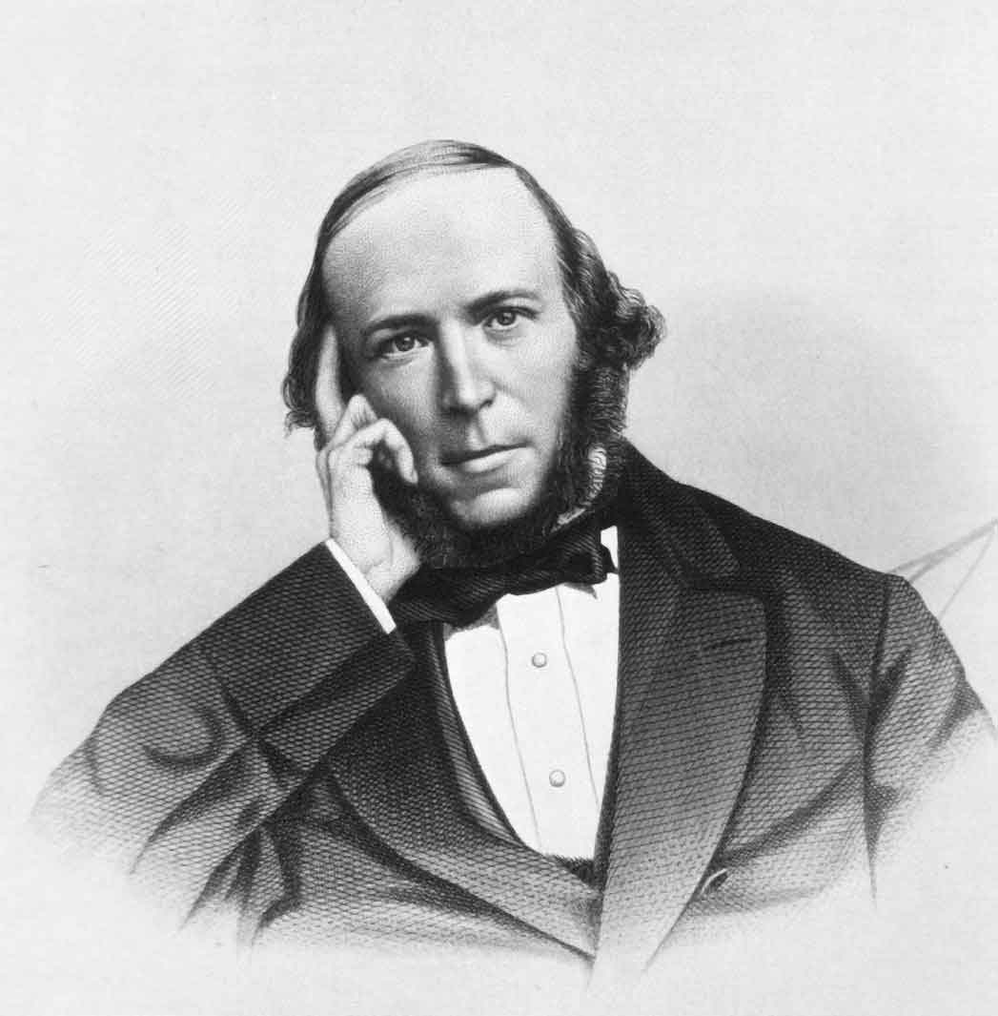
HERBERT SPENCER (1820-1903)

Slide 2
HERBERT SPENCER (1820-1903)
Brief background:
Born on April 27, 1820, in Derby, Britain.
Sickling and weak at childhood, did not attend a regular school.
Father educated him at home: mathematics and the natural sciences.
At 17, unfit for a university career, followed his scientific interests by joining the staff of the London and Birmingham Railway as an engineer.

Slide 3
The Evolutionary Doctrine
It is a change from a state of relatively indefinite, incoherent, homogeneity to a state of relatively definite, coherent, heterogeneity.
First, it involves progressive change from incoherence to coherence (increasing integration in form).
Second, increasing integration is the movement from homogeneity to heterogeneity (increasing differentiation of parts and functions).
Third, there is a movement from confusion to order, from indeterminacy to determined order (from the indefinite to the definite).
This was the universal law of progress, whether inorganic, organic, or super-organic (social).

Slide 4
The Evolutionary Doctrine cont.
Evolution is the master key to the riddles of the universe
‘There can be no complete acceptance of sociology as a science, so long as the belief in a social order not conforming to natural law, survives.’
Biological analogies occupy a privileged position in all of Spencer's sociological reasoning.
He, however, draws attention to the limitations of such analogies by indicating similarities and differences between the organic and the superorganic.

Slide 5
Social Types (Classification of Societies)
Society is but a collective name for a number of individuals.
The increasing differentiation and complex interdependence of parts in societies necessitate a regulating system for coordination.
Hence Spencer classifies societies based on their:
Evolutionary complexity
Degree of internal regulation
Classification is achieved through Comparison (methodology).

Slide 6
1. Classification by Evolutionary Complexity
Simple societies: no compounding yet in these societies, e.g. families.
Compound societies: Families combine into clans through conquest or peaceful cooperation or both. E.g. the oyoko, aduana, etc among the Akan. There is increased division of labour and political organization. Structures and functions are therefore more complex than in simple societies
Double compound: Clans unify into tribes. Politics, law, economic activities, knowledge and art become more complex.
Trebly compound: Tribes finally unify into states, nations; thus, increasing the complexity in structures and functions.
The stages of compounding and re-compounding have to be passed through in succession.

Slide 7
2. Classification of Societies Based on the Degree of Regulation
Militant Society (Compulsory Cooperation)
Industrial Society (Voluntary Cooperation)

Slide 8
Characteristic | Militant society | Industrial Society
Dominant function or activity | Corporate defensive and offensive activity for preservation and aggrandizement. | Peaceful, mutual rendering of individual services.
Principle of social coordination | Compulsory cooperation; regimentation by enforcement of orders; both positive and negative regulation of activity. | Voluntary cooperation; regulation by contract and principles of justice; only negative regulation of activity.
Relations between state and the individual | Individuals exist for the benefit of the state; restraints on liberty, property and mobility | State exists for benefit of individuals; freedom; few restraints on property and mobility
Relations between state and other organizations | All organizations public; private organizations excluded. | Private organizations encouraged.
Structure of state | Centralized | Decentralized
Structure of social stratification | Fixity of rank, occupation and locality; inheritance of positions. | Plasticity and openness of rank, occupation and locality; movement between positions.
Type of economic activity | Economic autonomy and self-sufficiency; little external trade; protectionism. | Loss of economic autonomy; interdependence via peaceful trade; free trade.
Valued social and personal characteristics | Patriotism; courage; reverence; loyalty; obedience; faith in authority and discipline | Independence; respect for others; resistance to coercion; individual initiative; truthfulness; kindness.

Slide 9
Organismic Analogy
He developed the tendency to see society as an organism in his theory of organic analogy.
He was concerned with overall structure of society, the interrelationship of the parts of society, and the functions of the parts for each other as well as for the system as a whole.
He had compared the society with a living organism by taking into account the following points.

Slide 10
3. Organismic Analogy
Like Comte, Spencer conceived of society as a biological organism.
According to Spencer ‘living together arose because, on the average, it proved more advantageous to each than living apart.’
Maintenance of combination [of individuals] is maintenance of conditions more satisfactory to living than the combined persons would otherwise have.
Thus, the quality of a society ,to a large extent, depends on the quality of the individuals who formed it.
‘There is no way of coming at a true theory of society, but by inquiry into the nature of its component individuals.’
Thus, the properties of the units determine the properties of the aggregate.

Slide 11
Similarities b/n the Organic and Superorganic
Increase in size and structure (visible growth).
Close relationship in its parts and organs.
Importance of the whole in both society and living organism.
One centre of control in both society and living organism.
Both follow similar processes and methods for its efficient functioning.

Slide 12
Differences b/n the Organic and Superorganic
Degree of connectedness: Parts of the organism are encased in a skin whereas societal parts are dispersed
Level of consciousness and voluntarism: Consciousness in the organism is concentrated at one part whereas it is dispersed in society
Mode of contact and interaction: The superorganic relies on symbols/language for communication whereas the organic does not.
The parts of the society are capable of independent existence but the parts of living organism are incapable of independent existence.

Slide 13
Non-intervention and Survival of the Fittest
Spencer argued that society must be free from the meddling of governments and reformers.
The state should only provide protection of the rights of the individual against outside enemies.
Everything else should be left to the free initiative of individuals making contracts and agreements with one another.
The least intelligent groups and individuals die off naturally; hence, the general level of intelligence is bound to rise gradually.
Those who are unfit to live will be selected by nature to die off thus purifying the society of poverty, weakness, disease, hunger, malnutrition, etc

